Slide 1

Green Pace
Security Policy Presentation
Developer: Ethan Mayberry

Slide 2

OVERVIEW: DEFENSE IN DEPTH
This security policy’s purpose is to act as a collection of best practices and standards thet we have set to uphold the safety and security of our data and software. Parts of the policy laid out here make up just some of the layers of the Defense-in-Depth strategy.

Slide 3
THREATS MATRIX
Likely – Probable chance of occurring. Typically, low in severity.
Unlikely – Not a probable chance to occur. Typically, high in severity.
Low Priority – Not a probable chance to occur. Typically, low in severity.
Priority - Probable chance of occurring. Typically, high in severity.
Likely STD-004-CPP | Priority STD-002-CPP STD-010-CPP
Low priority STD-001-CPP STD-005-CPP STD-007-CPP STD-009-CPP | Unlikely STD-003-CPP STD-006-CPP STD-008-CPP

Slide 4
10 PRINCIPLES
Security Principle | Coding Standard
1. Validate Input Data | STD-001-CPP,
2. Heed Compiler Warnings | STD-002-CPP
3. Design for Security Policies | STD-006-CPP, STD-010-CPP
4. Keep It Simple | STD-002-CPP, STD-008-CPP
5. Default Deny | STD-004-CPP
6. Principle of Least Privilege | STD-009-CPP
7. Sanitize Data Sent to Other Systems | STD-004-CPP
8. Practice Defense-in-Depth | STD-005-CPP
9. Effective Quality Assurance Techniques | STD-003-CPP, STD-007-CPP
10. Adopt a Secure Coding Standard | STD-003-CPP, STD-008-CPP

Slide 5
CODING STANDARDS
(Sorted Asc. by Priority)
Coding Standard Name | Coding Standard Description
STD-004-CPP | Sanitize and Validate queries
STD-001-CPP | Use header files to introduce objects. Consider Value limits
STD-005-CPP | Check for successful Memory Allocation before proceeding
STD-007-CPP | Do not leak resources. Be sure exceptions are handled properly
STD-009-CPP | Close files when they are no longer required
STD-003-CPP | Range check element access
STD-010-CPP | Do not attempt to modify String Literals
STD-002-CPP | Value-returning functions must return a value from all exit paths
STD-006-CPP | Understand the termination behavior of assert() and abort()
STD-008-CPP | Write constructor member initializers in the canonical order

Slide 6
ENCRYPTION POLICIES
Encryption | Explain what it is and how and why the policy applies.
Encryption at rest | This type of encryption is what protects any data that is stored on a device such as hard drives and smartphones. Only users who are authorized and select applications can decrypt this data when the access is requested so long as the encryption key they have is correct. This is a foundational part of any good Defense in Depth, and it helps to enforce regulated compliance.
Encryption in flight | This type of encryption is what protects any data that is in motion or travel. A few examples of this would be data being moved between networks, clients, and services. The design was created to prevent any sort of tampering or monitoring on server links. This is a great way to ensure that the data received is the same data that was sent out.
Encryption in use | This type of encryption is what protects any data that is being handled or processed by a computer system. A few examples of this include actively edited, read, or processed files. This helps to stop threats by ensuring they cannot steal usable data from active memory.

Slide 7
TRIPLE-A POLICIES
Triple-A Framework* | Explain what it is and how and why the policy applies.
Authentication | This is a great way to verify that the user signing in is exactly who they say they are. Multi-Factor Authentication is a great way to minimize risk of someone accessing data after a successful phishing attempt. .
Authorization | This helps to determine what access a user can obtain, use, or modify. This is where the “least-privilege” approach to security is best enforced, as it keeps access to a bare minimum for a user base depending on their role.
Accounting | This helps to track, log, and keep record of any user activity on a given system, as well as keep track of any system changes made. Any suspicious behaviors will be seen thanks to its continued monitoring and auditing.

Slide 8
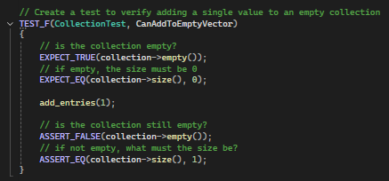
Unit Testing

Slide 9
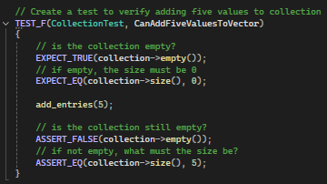
Unit Testing

Slide 10

AUTOMATION SUMMARY

Slide 11
TOOLS
  The DevSecOps pipeline demonstrates the flow that our developmental processes go through. These include:
      Pre-Production – The design and testing of a developing software
      Production – Deployment, monitoring, and maintenance of the working software
  [Summarize the external tools and where and how they are used in the context of the diagram.]

Slide 12
RECOMMENDATIONS
    Security policies, no matter their strength or possibilities, are useless unless it is understood and adhered to,
    Training in the DevSecOps workflow for any developers.
    The use of automation for monitoring software vulnerabilities and dependencies.
    Patches regularly for the prevention of attacks on the supply chain.

Slide 13
CONCLUSIONS
Training on both security and the set out security policies is a must.
The security policy should be reviewed and adjusted/updated regularly as security needs are always changing.
Security MUST be considered from the very start.
Enforcement should be in place to ensure this policy is followed by all working on software.

Slide 14
REFERENCES
Madskristensen. (2016, November 4). Use C++ assertion statements for debugging - Visual Studio (windows). Use C++ assertion statements for debugging - Visual Studio (Windows) | Microsoft Learn. https://learn.microsoft.com/en-us/visualstudio/debugger/c-cpp-assertions?view=visualstudio&viewFallbackFrom=vs-2019

